Slide 1
TOPIC:
Introduction Flip-Flops and Its Types

Slide 2
Types of Digital Circuits
Combinational Circuits
Sequential Circuits

Slide 3
Combinational Circuits
The outputs of the combinational circuit depend only on the present inputs.
The feedback path is not present in the combinational circuit.
In combinational circuits, memory elements are not required.
The clock signal is not required for combinational circuits.
The combinational circuit is simple to design.
Combinational Circuits are
Half and full Adder
Half and full subtractor
Binary Adder-subtractor
Decimal to BCD converter.

Slide 4
Adder
A logic circuit that performs the function of binary addition is called electronic adder or adder.
The adder circuit consists of properly connected logic gates.
There are usually two forms of the adder in common applications:
Half adder
Full adder

Slide 5
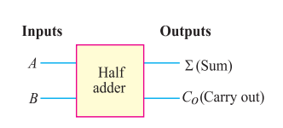
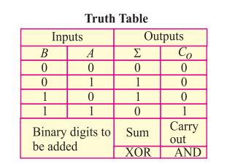
Adder
Half Adder
A logic circuit that can add two binary bits is called a half adder (HA)

Slide 6
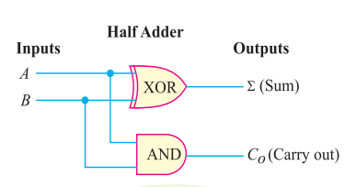
Adder
Half Adder Logic Circuit

Slide 7
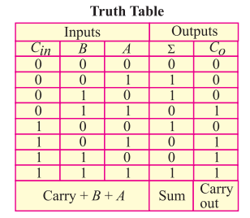
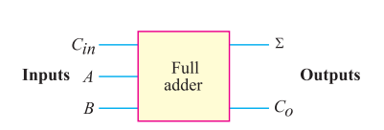
Adder
Full Adder
A full adder adds two binary bits plus a carry input (Cin) to produce the sum (Σ) and carry (Co) outputs.

Slide 8
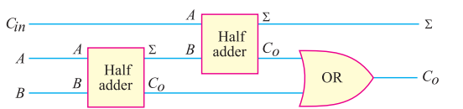
Adder
Full Adder Logic Circuit

Slide 9
Sequential Circuits
The outputs of the sequential circuits depend on both present inputs and present state(previous output).
The feedback path is present in the sequential circuits.
In the sequential circuit, memory elements play an important role and require.
The clock signal is required for sequential circuits.
It is not simple to design a sequential circuit.
Sequential Circuits are
Flip Flops
Registers
Counters
Latches etc.

Slide 10
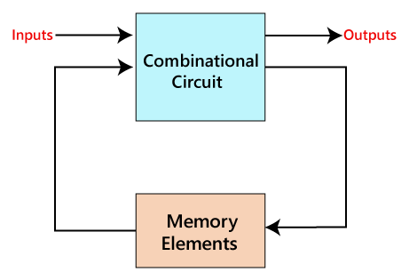
Sequential Circuits
The sequential circuit is a special type of circuit that has a series of inputs and outputs. The outputs of the sequential circuits depend on both the combination of present inputs and previous outputs. The previous output is treated as the present state. So, the sequential circuit contains the combinational circuit and its memory storage elements. A sequential circuit doesn't need to always contain a combinational circuit. So, the sequential circuit can contain only the memory element.

Slide 11
Introduction
There are two types of sequential circuits:
synchronous: outputs change only at specific time
asynchronous: outputs change at any time
Bistable logic devices: latches and flip-flops.
Latches and flip-flops differ in the method used for changing their state.

Slide 12
Types of Sequential Circuits
Asynchronous sequential circuits:
The clock signals are not used by the Asynchronous sequential circuits. The asynchronous circuit is operated through the pulses. So, the changes in the input can change the state of the circuit. The asynchronous circuits do not use clock pulses. The internal state is changed when the input variable is changed. The un-clocked flip-flops or time-delayed are the memory elements of asynchronous sequential circuits. The asynchronous sequential circuit is similar to the combinational circuits with feedback.
Synchronous sequential circuits:
In synchronous sequential circuits, synchronization of the memory element's state is done by the clock signal. The output is stored in either flip-flops or latches(memory devices). The synchronization of the outputs is done with either only negative edges of the clock signal or only positive edges.

Slide 13
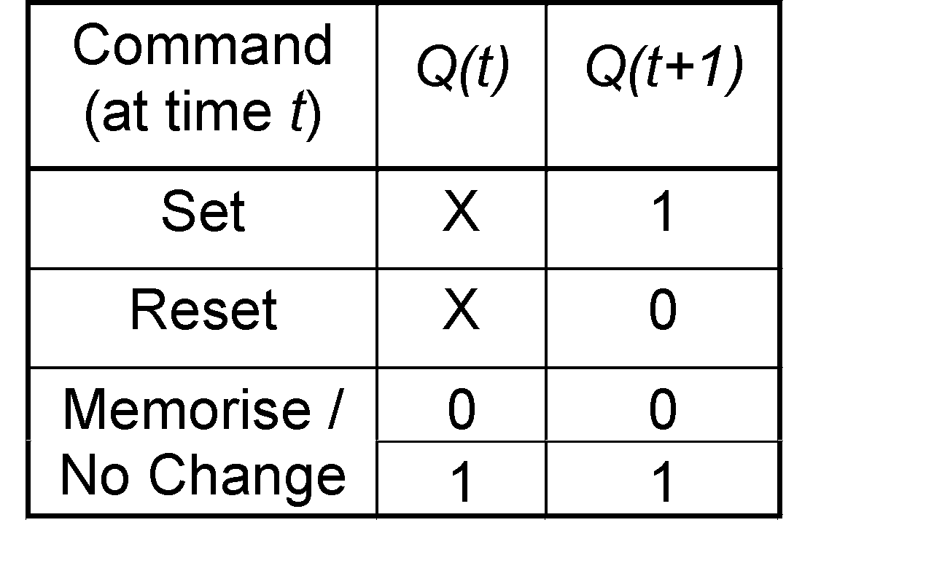
Memory Elements
Memory element: a device which can remember value indefinitely, or change value on command from its inputs.
Characteristic table:
Memory element
Q
command
stored value
Q(t): current state
Q(t+1) or Q⁺: next state

Slide 14
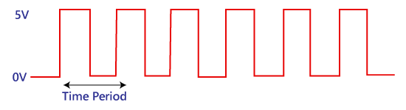
Clock Signal and Triggering
Clock signal
A clock signal is a periodic signal in which ON time and OFF time need not be the same. When ON time and OFF time of the clock signal are the same, a square wave is used to represent the clock signal. Below is a diagram which represents the clock signal:
A clock signal is considered as the square wave. Sometimes, the signal stays at logic, either high 5V or low 0V, to an equal amount of time. It repeats with a certain time period, which will be equal to twice the 'ON time' or 'OFF time'.

Slide 15
Memory Elements
Two types of triggering/activation:
pulse-triggered
edge-triggered
Pulse-triggered
latches
ON = 1, OFF = 0
Edge-triggered
flip-flops
positive edge-triggered (ON = from 0 to 1; OFF = other time)
negative edge-triggered (ON = from 1 to 0; OFF = other time)

Slide 16
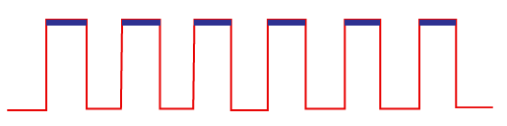
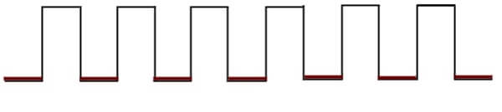
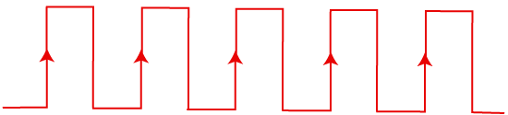
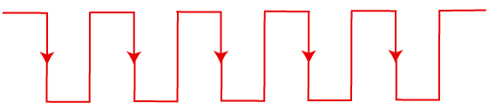
Types of Triggering
These are two types of triggering in sequential circuits:
1. Level triggering
Positive level triggering
Negative level triggering
2. Edge triggering
Positive edge triggering
Negative edge triggering
Fig: 1.4 Positive Level Triggering
Fig: 1.5 Negative Level Triggering
Fig: 1.6 Positive Edge Triggering
Fig: 1.7 Negative Level Triggering

Slide 17
S-R Latch
Complementary outputs: Q and Q'.
When Q is HIGH, the latch is in SET state.
When Q is LOW, the latch is in RESET state.
For active-HIGH input S-R latch (also known as NOR gate latch),
R=HIGH (and S=LOW) 🢧 RESET state
S=HIGH (and R=LOW) 🢧 SET state
both inputs LOW 🢧 no change
both inputs HIGH 🢧 Q and Q' both LOW (invalid)!

Slide 18
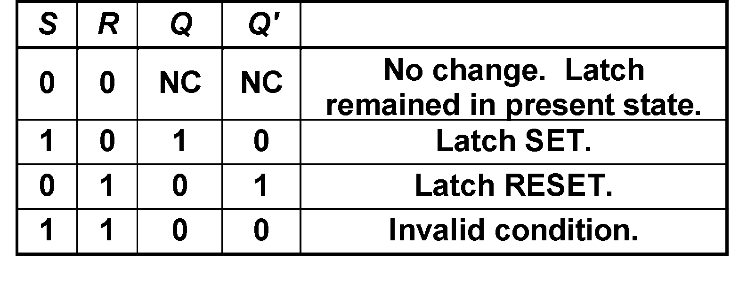
S-R Latch
Characteristics table for active-high input S-R latch:
S
R
Q
Q'

Slide 19
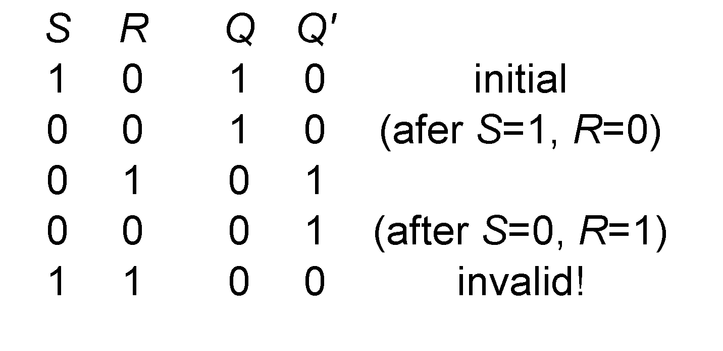
S-R Latch
Active-HIGH input S-R latch
1
0
1
0
0
R
1
1
0
0
Q
0
Q'
0
0
1
1
1
0
0
0
0
1
S

Slide 20
Gated D Latch
Make R input equal to S' → gated D latch.
D latch eliminates the undesirable condition of invalid state in the S-R latch.
D
Q
D
EN
Q
Q'
EN
Q'

Slide 21
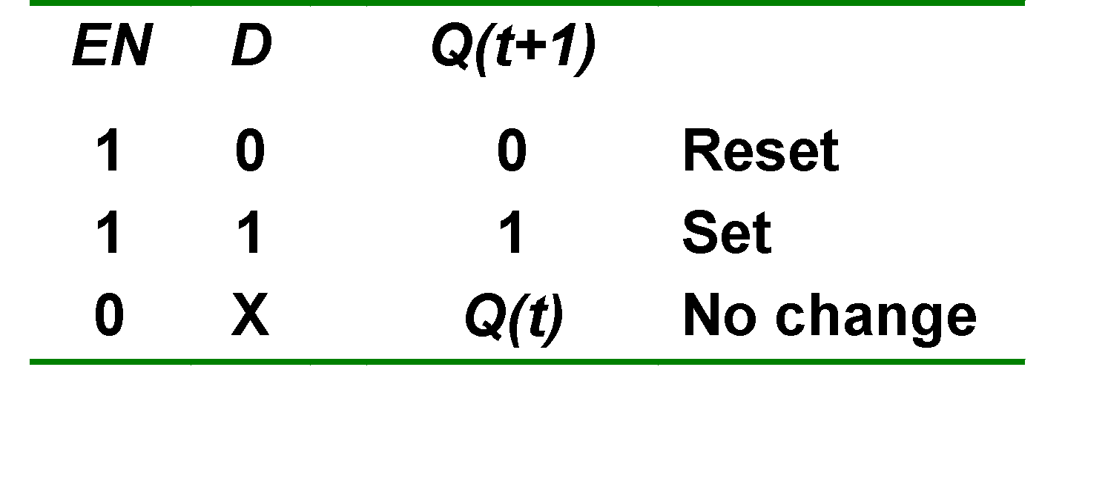
Gated D Latch
When EN is HIGH,
D=HIGH → latch is SET
D=LOW → latch is RESET
Hence when EN is HIGH, Q ‘follows’ the D (data) input.
Characteristic table:
When EN=1, Q(t+1) = D

Slide 22
Latch Circuits: Not Suitable
Latch circuits are not suitable in synchronous logic circuits.
When the enable signal is active, the excitation inputs are gated directly to the output Q. Thus, any change in the excitation input immediately causes a change in the latch output.
The problem is solved by using a special timing control signal called a clock to restrict the times at which the states of the memory elements may change.
This leads us to the edge-triggered memory elements called flip-flops.

Slide 23
Basics of Flip Flop
A circuit that has two stable states is treated as a flip flop. These stable states are used to store binary data that can be changed by applying varying inputs. The flip flops are the fundamental building blocks of the digital system. Flip flops and latches are examples of data storage elements. In the sequential logical circuit, the flip flop is the basic storage element. The latches and flip flops are the basic storage elements but different in working. There are the following types of flip flops:
1. SR Flip Flop
2. J-K Flip-flop
3. D Flip Flop
4. T Flip Flop

Slide 24
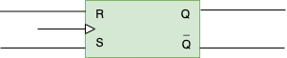
SR Flip Flop
It is a Flip Flop with two inputs, one is S and other is R. S here stands for Set and R here stands for Reset.
Set basically indicates set the flip flop which means output 1 and reset indicates resetting the flip flop which means output 0.
Here clock pulse is supplied to operate this flip flop, hence it is clocked flip flop.
SR Flip Flop basic Block diagram

Slide 25
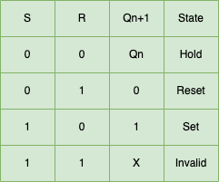
Truth Table of SR Flip Flop

Slide 26
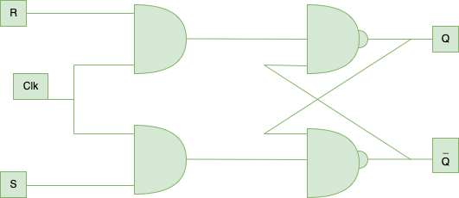
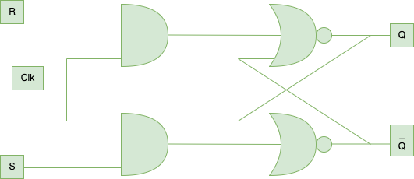
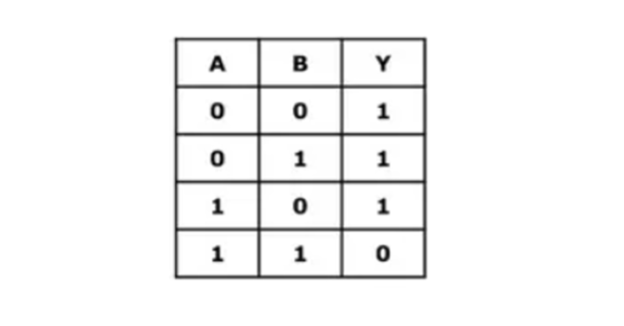
Working of SR Flip Flop
Case 1: Let’s say, S=0 and R=0, then output of both AND gates will be 0 and the value of Q and Q’ will be same as their previous value, i.e, Hold state.
Case 2: Let’s say, S=0 and R=1, then output of both AND gates will be 1 and 0, correspondingly the value of Q will be 0 as one of input is 1 and it is a NOR gate so it will ultimately gives 0, hence Q gets 0 value, similarly Q’ will be 1.
Case 3: Let’s say, S=1 and R=0, then output of both AND gates will be 0 and 1, correspondingly the value of Q’ will be 0 as one of input to NOR gate is 1, so output will be 0 ultimately and this 0 value will go as input to upper NOR gate, and hence Q will become 1.
Case 4: Let’s say, S=1 and R=1, then output of both AND gates will be 1 and 1 which is invalid, as the outputs should be complement of each other.
SR Flip Flop
NAND Gate Truth Table
SR Flip Flop Construction using 2 NOR + 2 AND Gates

Slide 27
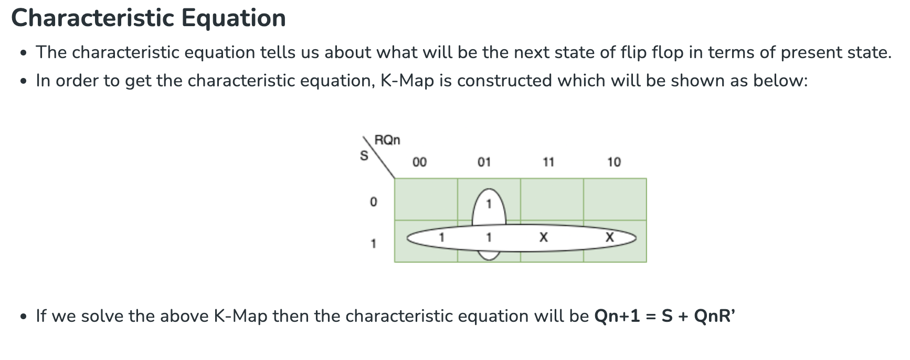
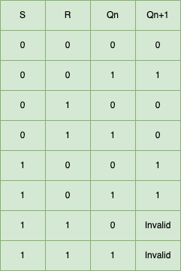
Applications of SR Flip Flop
There are numerous applications of SR Flip Flop in Digital System, which are listed below:
Register: SR Flip Flop used to create register. Designer can create any size of register by combining SR Flip Flops.
Counters: SR Flip Flops used in counters. Counters counts the number of events that occurs in a digital system.
Memory: SR Flip Flops used to create memory which are used to store data, when the power is turned off.
Synchronous System: SR Flip Flop are used in synchronous system which are used to synchronise the operation of different component.
Characteristic Table of SR Flip Flop

Slide 28
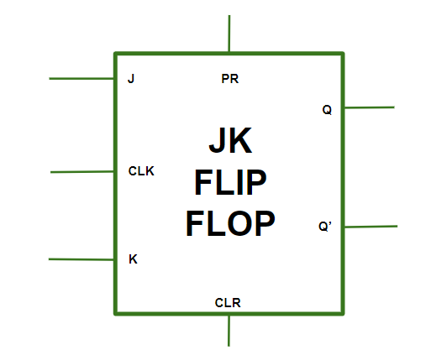
J-K Flip Flop
It is one kind of sequential logic circuit which stores binary information in bitwise manner.
It consists of two inputs and two outputs. Inputs are Set(J) & Reset(K) and their corresponding outputs are Q and Q’.
JK flipflop has two modes of operation which are synchronous mode and asynchronous mode.
In synchronous mode, the state will be changed with the clock (clk) signal, and in asynchronous mode, the change of state is independent from its clock signal.
Diagram Structure
The JK flip flop diagram above represents the basic structure which consists of Clock (CLK), Clear (CLR), and Preset (PR).

Slide 29
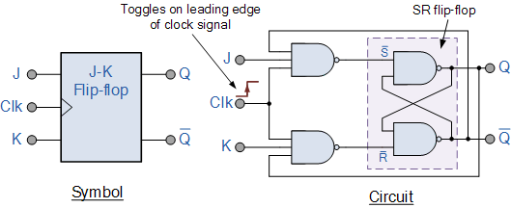
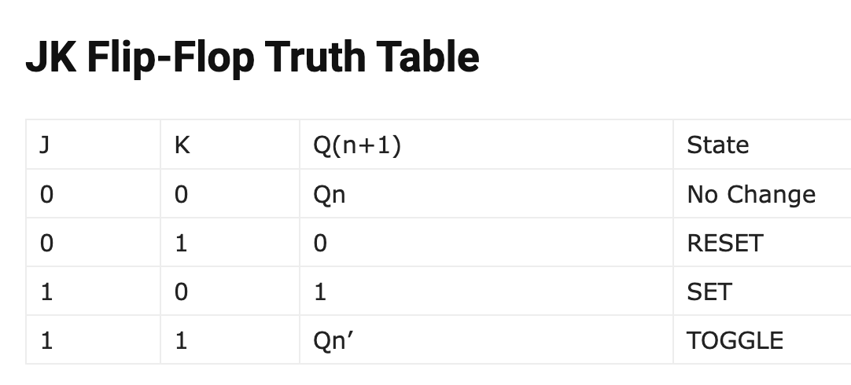

Slide 30
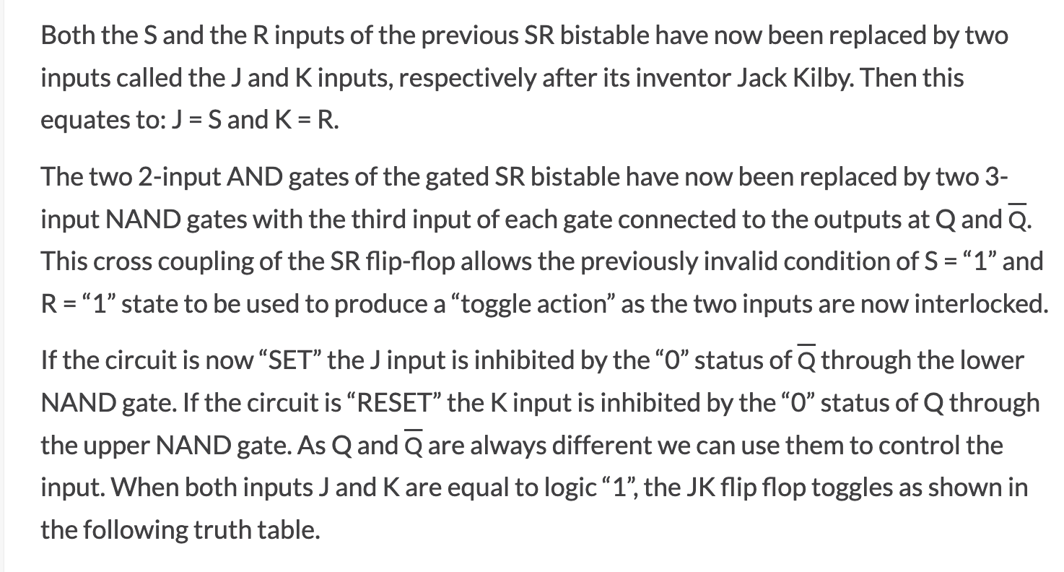

Slide 31
Applications of JK Flip-Flop
Counters: These are very essential components for the application of frequency dividers and event sequencers where there is a need of storing and propagating the count value. We can design binary synchronous and asynchronous counters using JK-flipflop.
Shift registers: For data storage and manipulation, serial-to-parallel or parallel-to-serial data conversion the shift registers are widely used. Registers can store and shift the binary data in a sequential manner. We can design it by JK-flipflops.
Memory Units: JK-flipflop itself act as a memory unit to store binary information. By making a sequential chain of JK-flipflops we can use it even as RAM.

Slide 32
Advantages of JK Flip-Flop
Versatility: As discussed above, JK-flipflops can be used as a basic memory element or a primary building block of further complex memory design. It is very much adaptive as it can be operated in both synchronous and asynchronous modes.
Toggle Functionality: The application which are required to get output as its complement of input that also can be developed by JK-flipflops as when J=K=1 it triggers toggle state which gives output which is complement with it’s each clock pulse.
Error Detection and Correction: We can use a complex circuit built by JK-flipflops which can detect and correct information during data-transmission.
Disadvantages of JK Flip-Flop
Complexity: Compared to other types of flipflops(D,T, SR), JK flipflop requires additional logic gates to implement which consumes extra memory resources and increases complexity to operate.
Propagation Delay: This is the major problem present in JK-FF. Propagation delay results a timing delay in certain application which are time-flow sensitive.
Race Problem: This issue arises when the clock input’s timing pulse isn’t given enough time to turn “Off” before the output Q’s state is altered.

Slide 33
J-K Flip-flop
The JK flip flop is used to remove the drawback of the S-R flip flop, i.e., undefined states. The JK flip flop is formed by doing modification in the SR flip flop. The S-R flip flop is improved in order to construct the J-K flip flop. When S and R input is set to true, the SR flip flop gives an inaccurate result. But in the case of JK flip flop, it gives the correct output.
In J-K flip flop, if both of its inputs are different, the value of J at the next clock edge is taken by the output Y. If both of its input is low, then no change occurs, and if high at the clock edge, then from one state to the other, the output will be toggled. The JK Flip Flop is a Set or Reset Flip flop in the digital system.

Slide 34
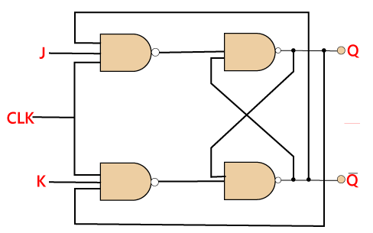
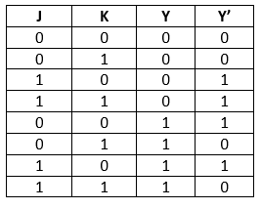
J-K Flip-flop
The JK flip flop is used to remove the drawback of the S-R flip flop, i.e., undefined states. The JK flip flop is formed by doing modification in the SR flip flop. The S-R flip flop is improved in order to construct the J-K flip flop. When S and R input is set to true, the SR flip flop gives an inaccurate result. But in the case of JK flip flop, it gives the correct output.
In J-K flip flop, if both of its inputs are different, the value of J at the next clock edge is taken by the output Y. If both of its input is low, then no change occurs, and if high at the clock edge, then from one state to the other, the output will be toggled. The JK Flip Flop is a Set or Reset Flip flop in the digital system.
Truth Table:

Slide 35
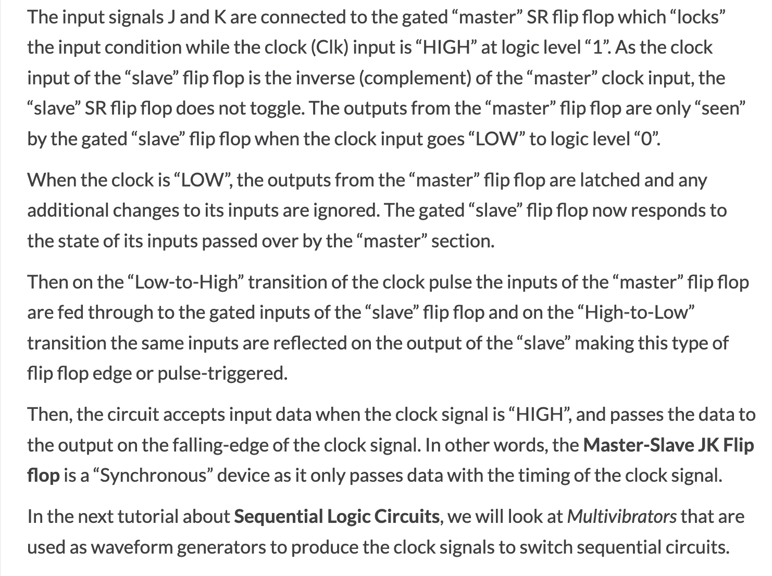
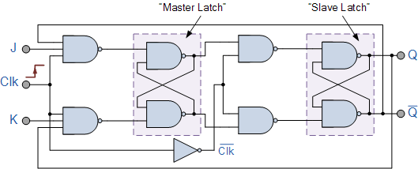
The Master-Slave Configuration

Slide 36
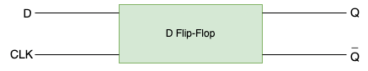
D Flip Flop
D flip flop is an electronic devices that is known as “delay flip flop” or “data flip flop” which is used to store single bit of data.
D flip flops are synchronous or asynchronous.
The clock signal required for the synchronous version of D flip flops but not for the asynchronous one.
The D flip flop has two inputs, data and clock input which controls the flip flop. when clock input is high, the data is transferred to the output of the flip flop and when the clock input is low, the output of the flip flop is held in its previous state.

Slide 37
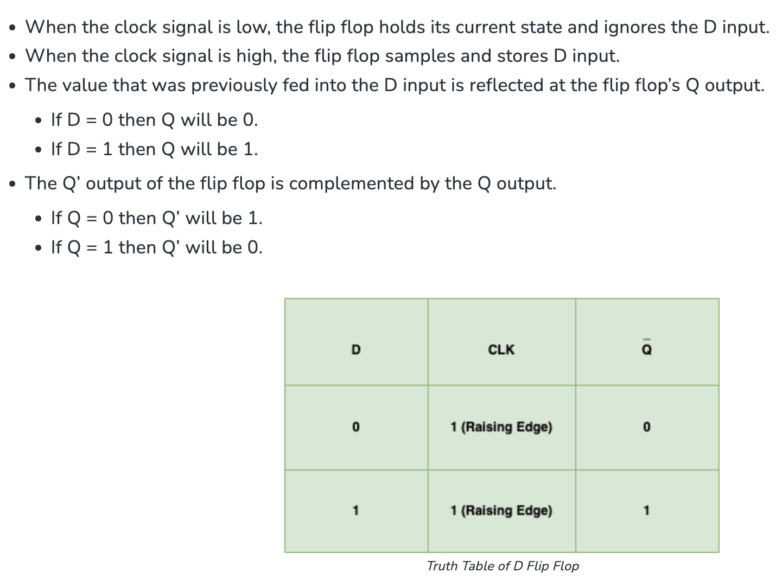
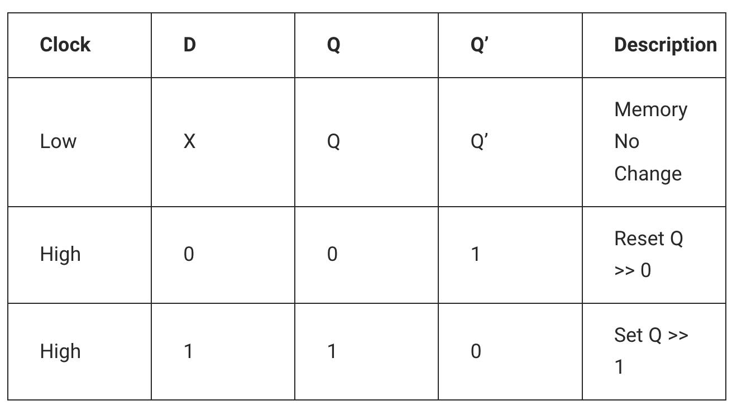
Working of D Flip Flop
D flip flop consist of a single input D and two outputs (Q and Q’). The basic working of D Flip Flop is as follows:

Slide 38
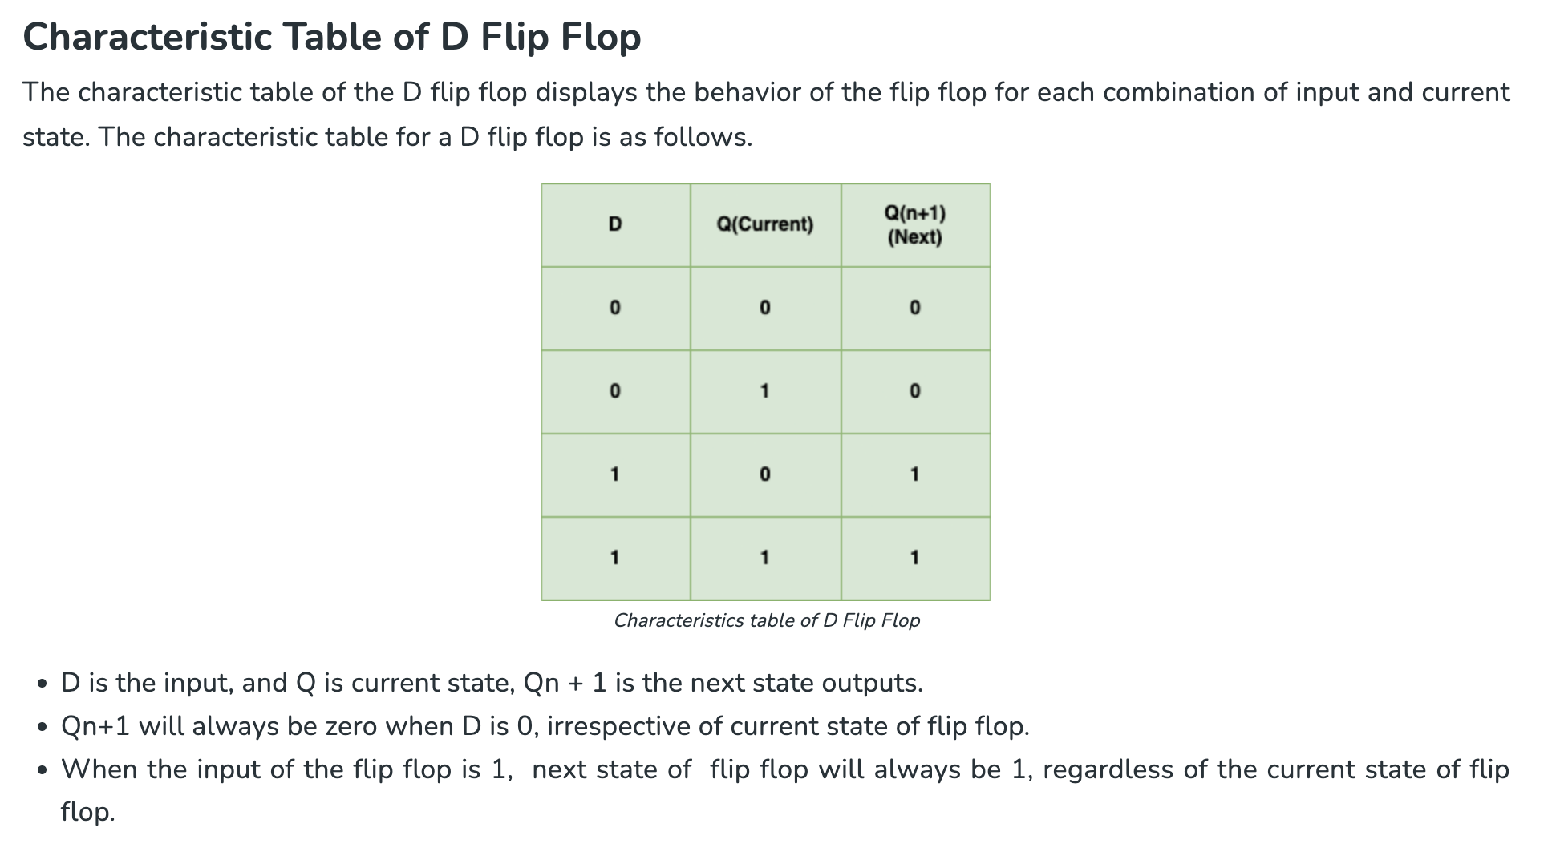
The characteristics table provides the information about the upcoming state in response to the specific inputs

Slide 39
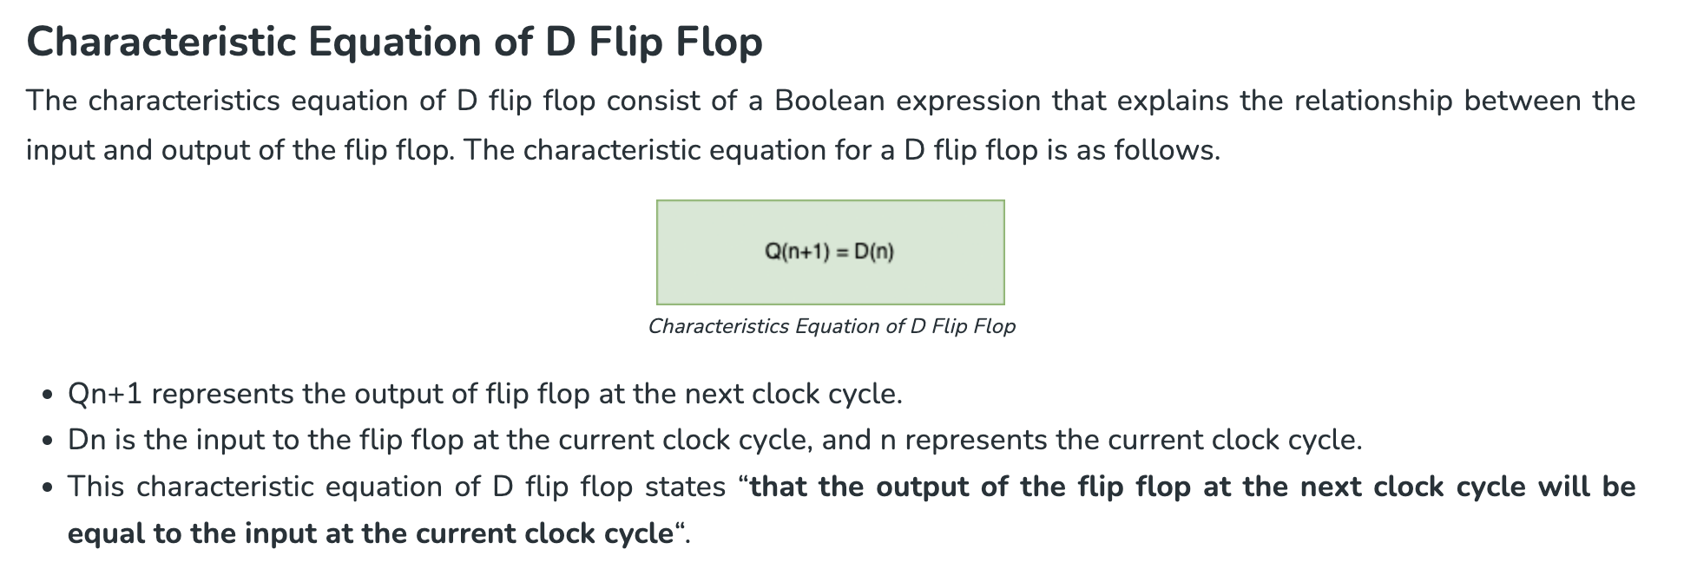

Slide 40
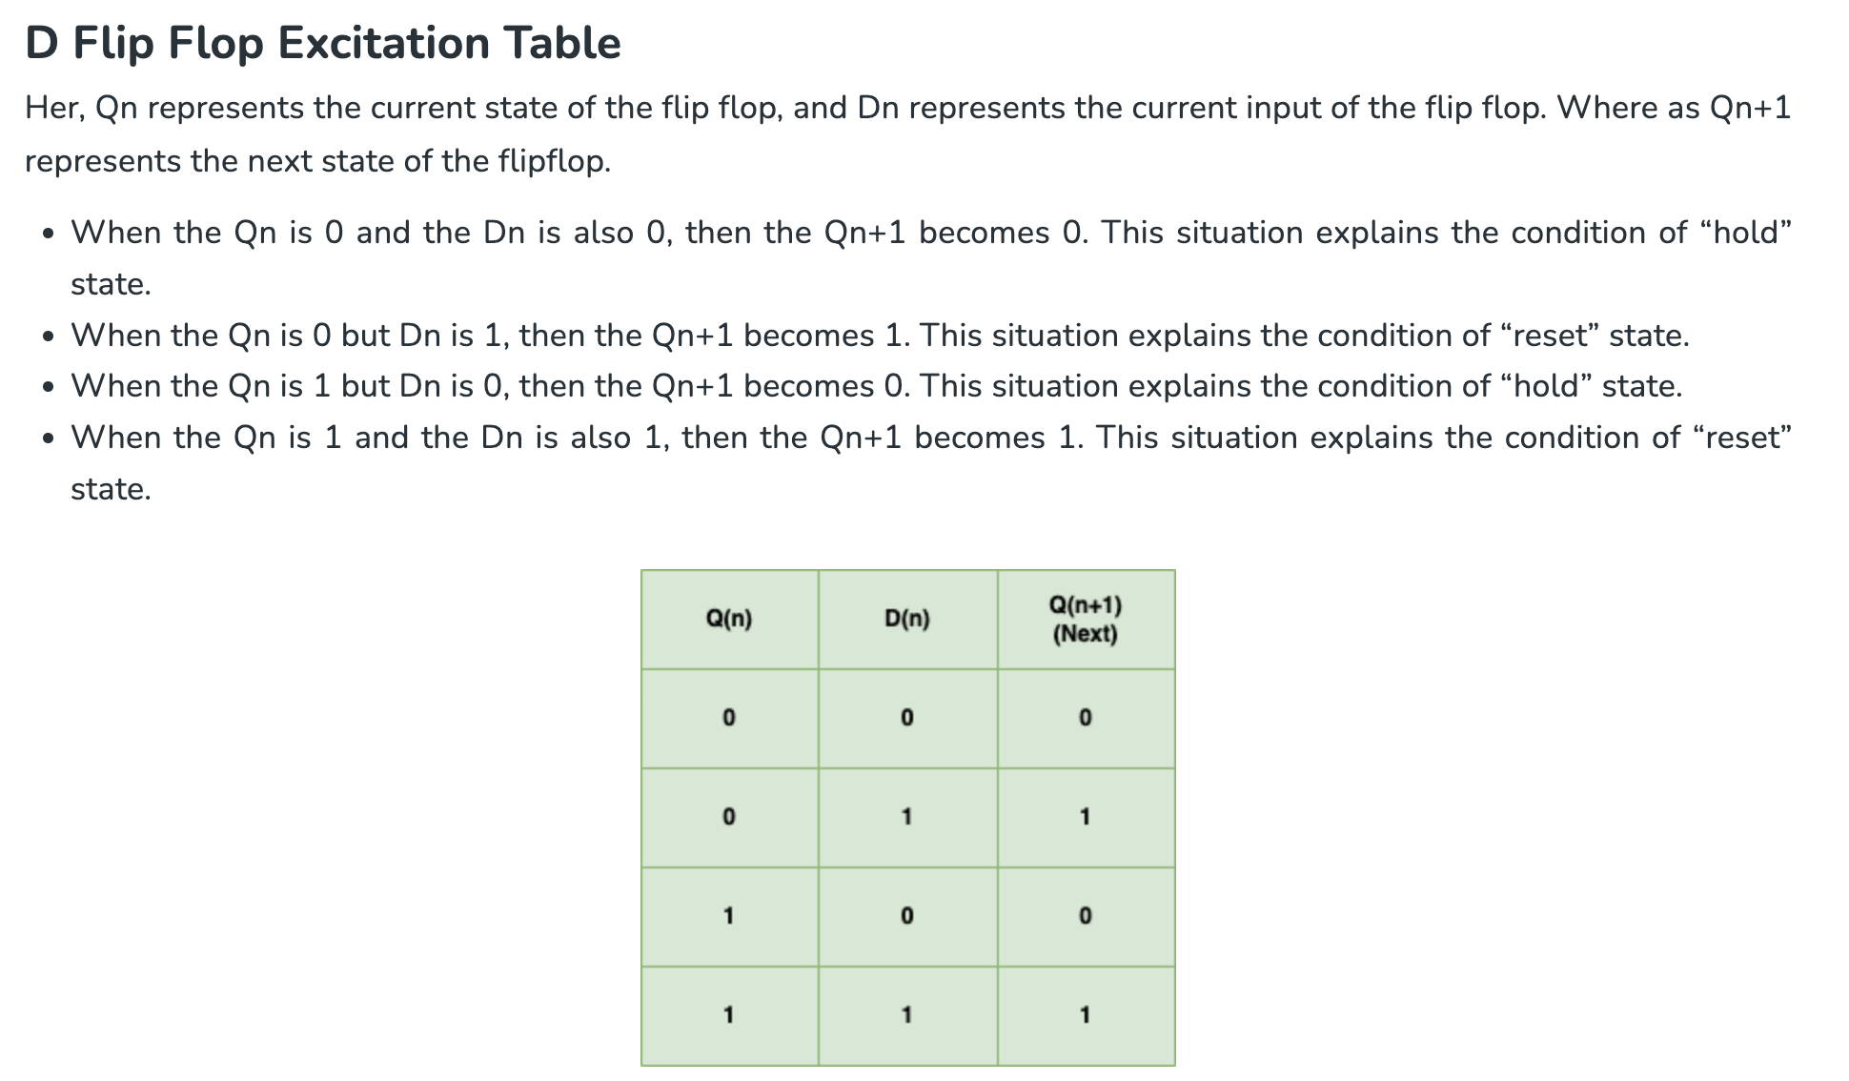
An excitation table shows the minimum inputs that are necessary to generate a particular next state when the current state is known.

Slide 41
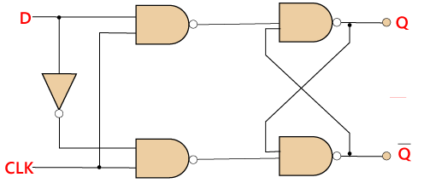
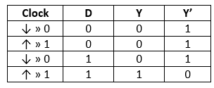
D Flip Flop
D flip flop is a widely used flip flop in digital systems. The D flip flop is mostly used in shift-registers, counters, and input synchronization.
Truth Table:

Slide 42
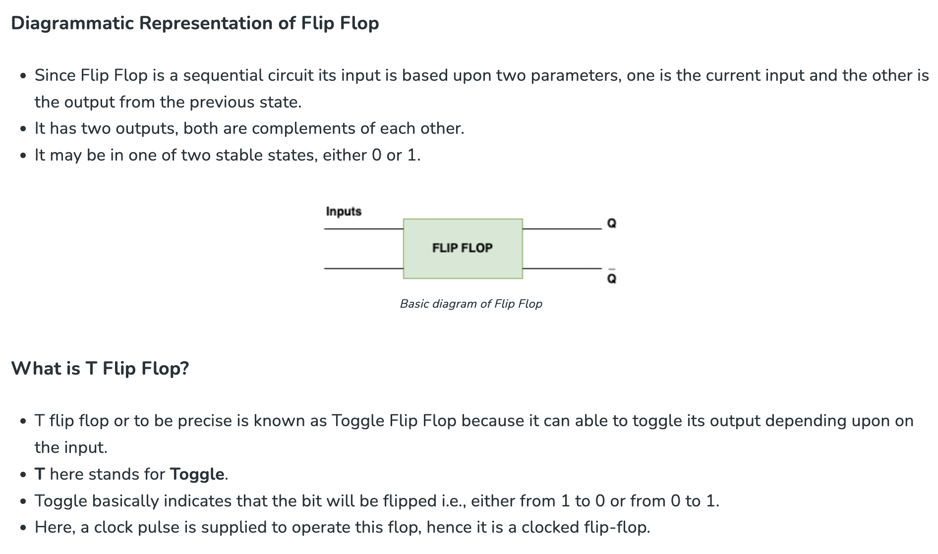
T Flip Flop
Flip-flop is a term that comes under digital electronics, and it is an electronic component that is used to store one single bit of information.

Slide 43
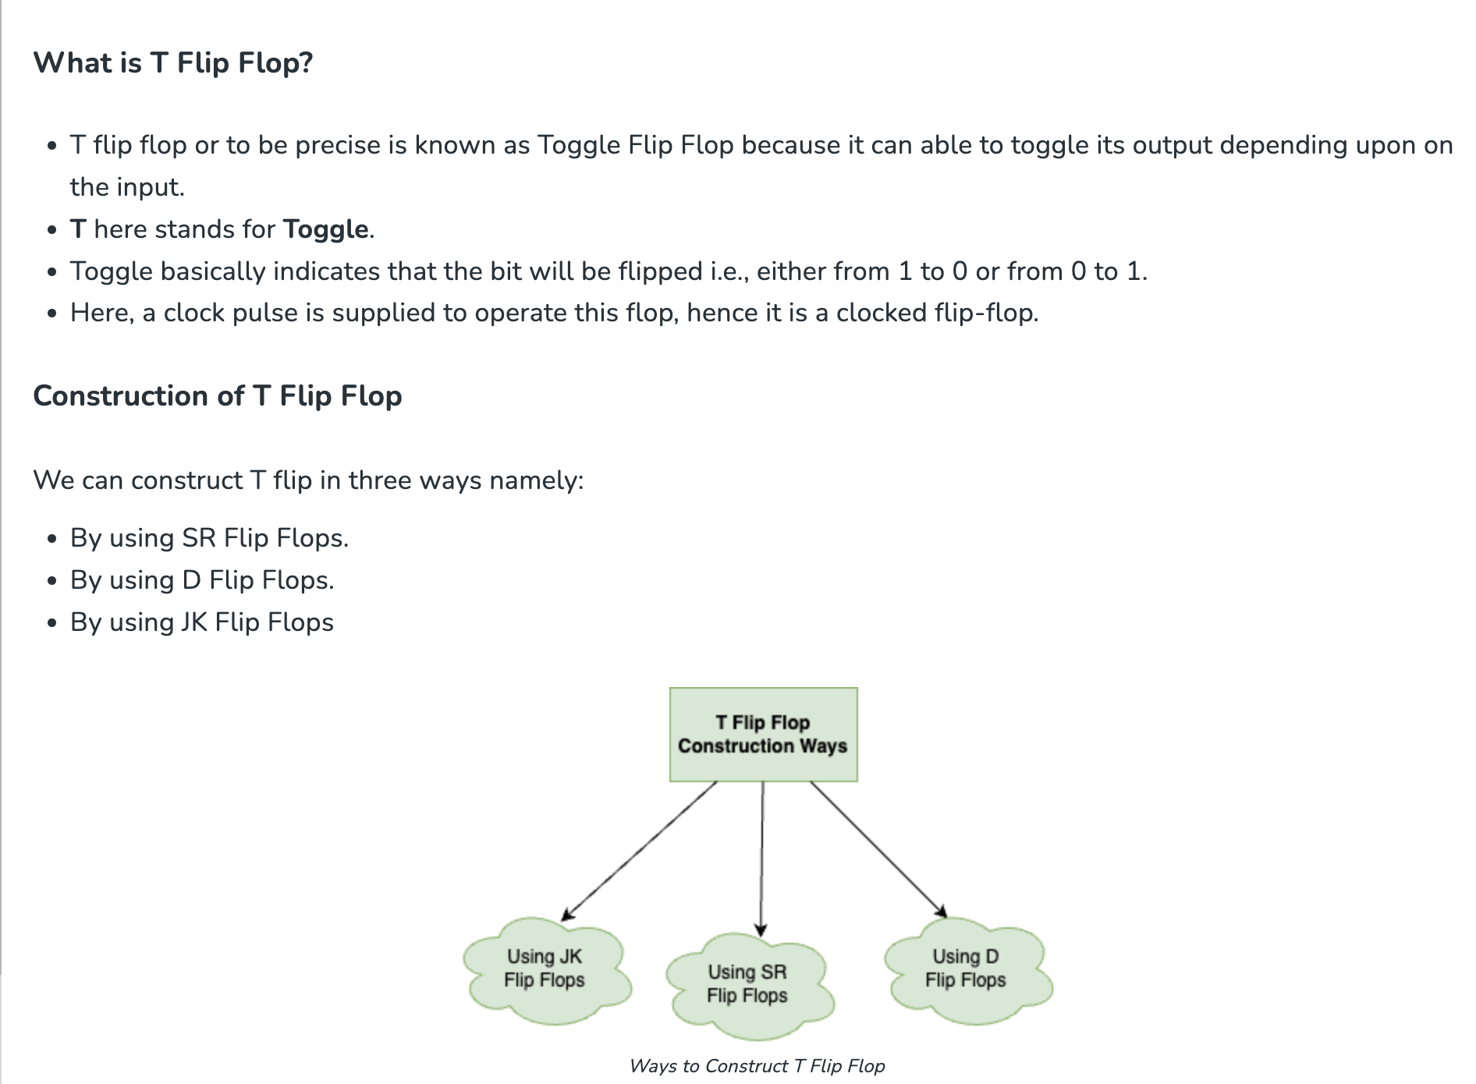

Slide 44
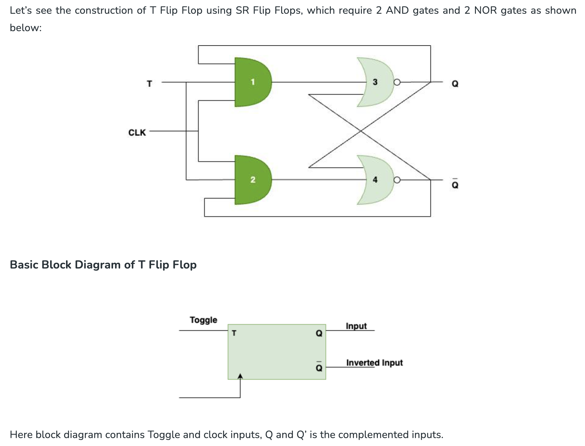
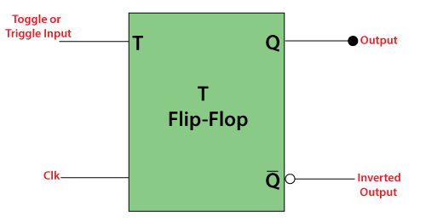

Slide 45
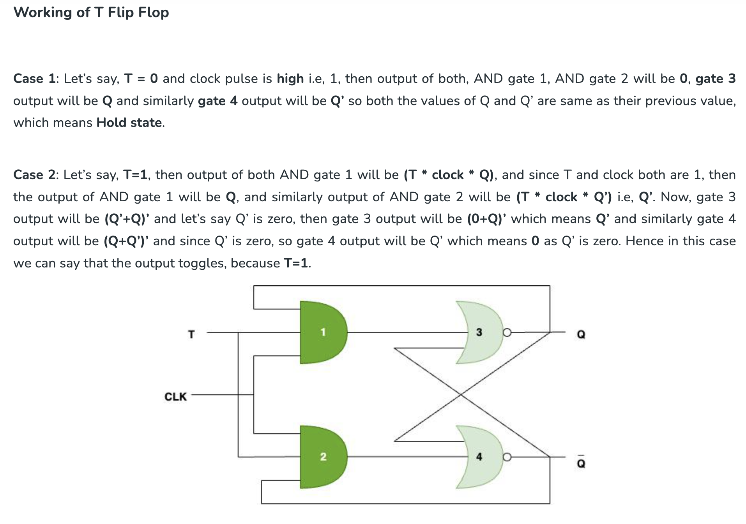

Slide 46
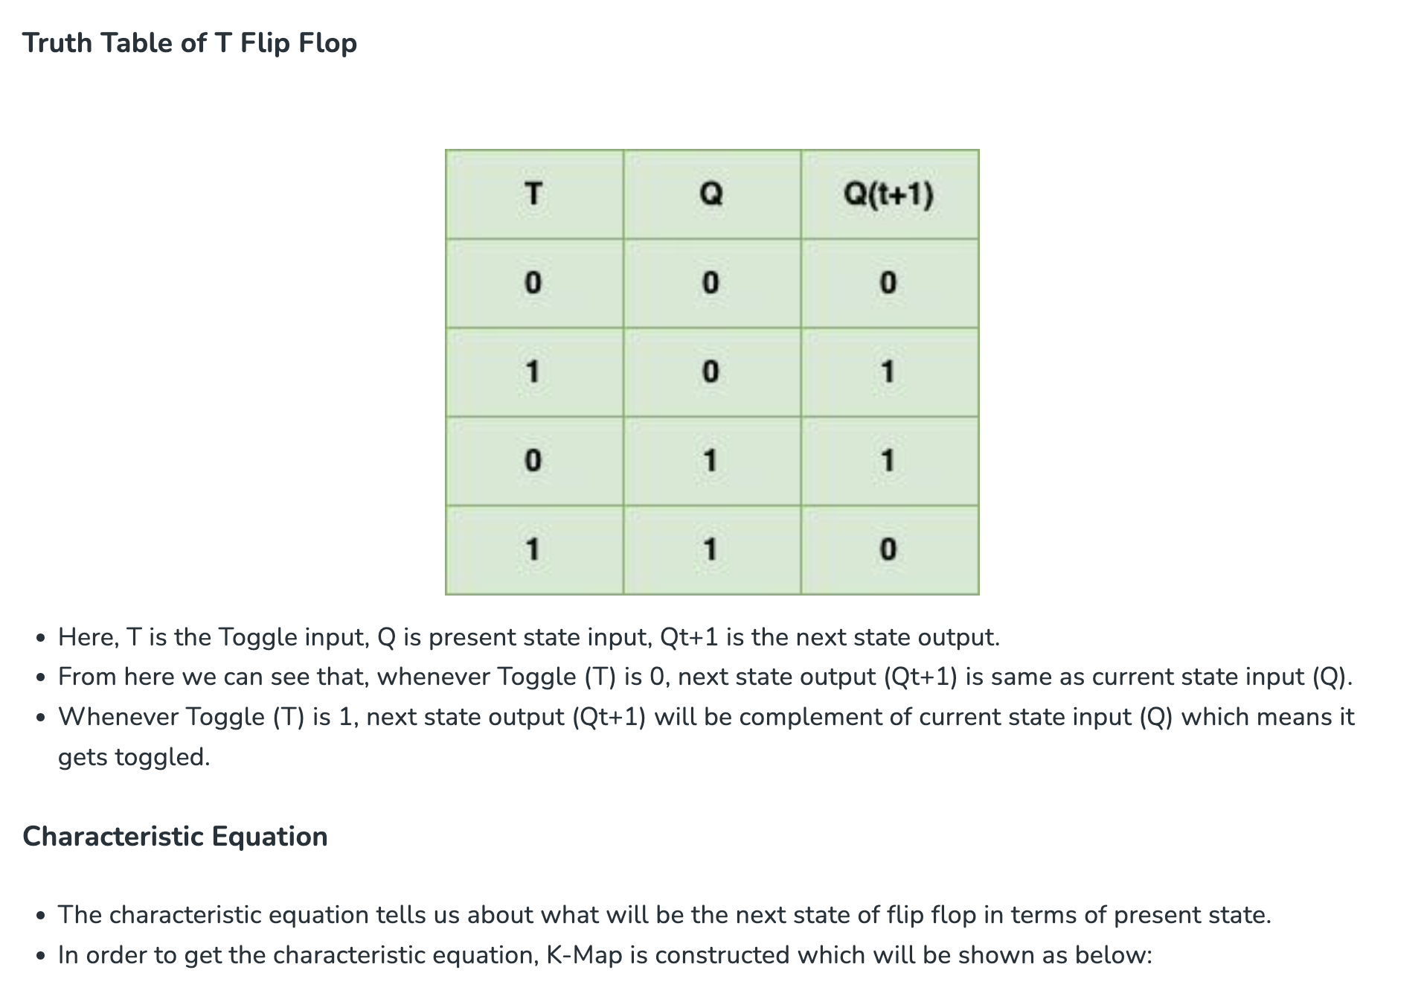

Slide 47
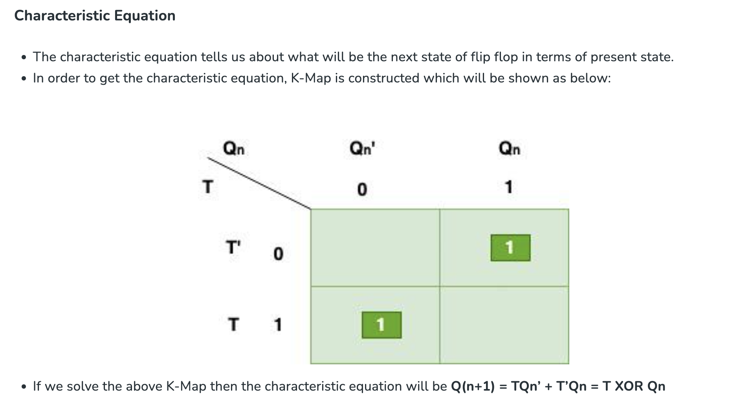

Slide 48
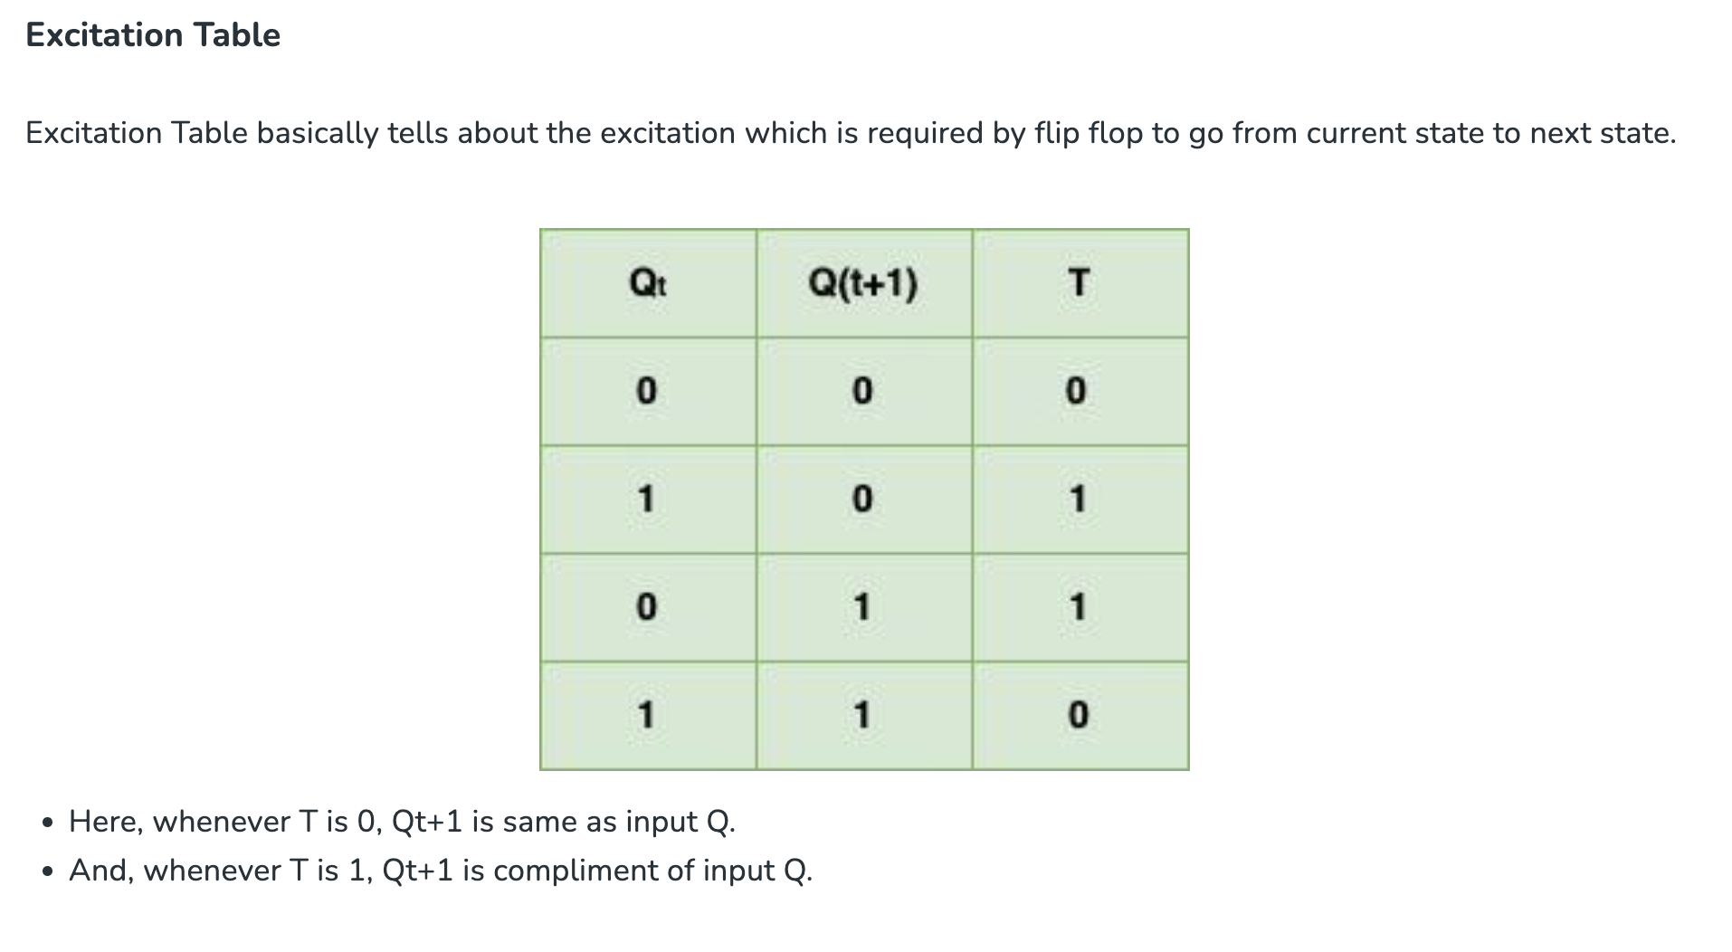

Slide 49
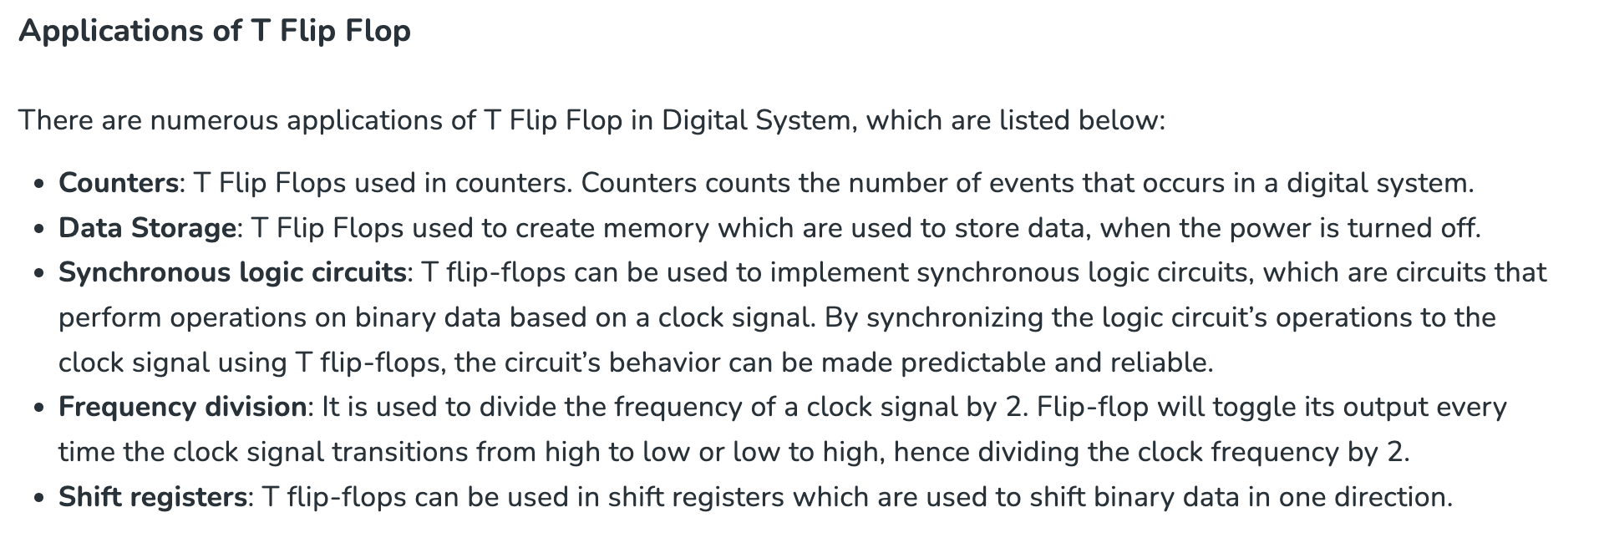

Slide 50
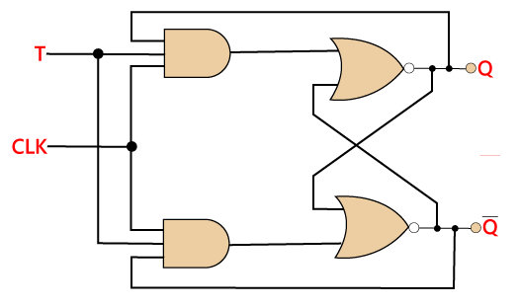
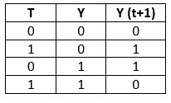
T Flip Flop
Just like JK flip-flop, T flip flop is used. Unlike JK flip flop, in T flip flop, there is only single input with the clock input. The T flip flop is constructed by connecting both of the inputs of JK flip flop together as a single input. The T flip flop is also known as Toggle flip-flop. These T flip-flops are able to find the complement of its state.
Truth Table:

Slide 51
The End

